Slide 1
Introduction to Programming
Workshop
15 December 2016
Peter Smyth
UK Data Service

Slide 2
Accessing the course materials
The code snippets used, the file needed for the final exercise, the additional exercises and a copy of the notes are all available on Github at;
https://github.com/pfsmyth/Cambridge
Download the zip file and extract it to your laptop, somewhere where you can access it easily

Slide 3
Overview of this workshop
This is what we will cover:
What is a computer program?
Defining the problem in words and pictures
Documentation
Python programming constructs
Coding environments
Debugging
More Python
Introduction to testing
Re-using code and packages
Introduction to small programs
Notes:
Leave this for Peter

Slide 4
Computer programming
Art ?
or
Science?

Slide 5
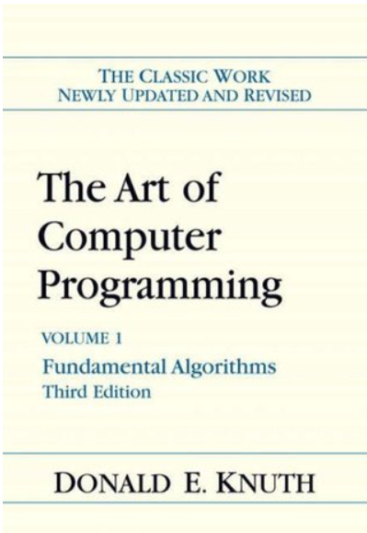
Computer programming

Slide 6
Lesson 1
What is a computer Program?

Slide 7
Lesson 1
Definitions
computer program - a sequence of instructions that a computer can interpret and execute.
(The Free Dictionary)
A computer program is a collection of instructions that performs a specific task when executed by a computer.
(Wikipedia)

Slide 8
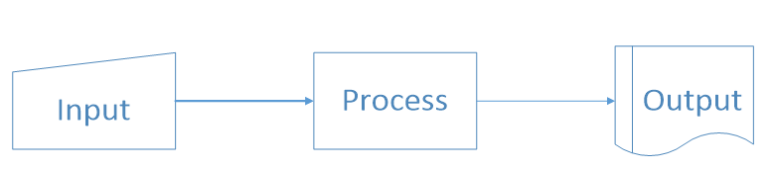
Lesson 1
In pictures
Question – Give examples of input and output

Slide 9

Lesson 1
A simple program
"Hello, World" source code. This first known "Hello, world" snippet from the seminal book The C Programming Language originates from Brian Kernighan and Dennis Ritchie in 1974.

Slide 10
Lesson 1
It is generally easier to read programs than to write them
Regardless of the language
It is usually necessary to add symbols (or tokens) to the written code in order to make it understandable by the computer.
This can help to ensure that the code is not ambiguous

Slide 11
Lesson 1 – stupid computers
Computers can;
Add
Subtract
Compare
And that’s about it!

Slide 12
Lesson 1 – How Programs are run
In very simple terms –
You write your program code to a file as simple text
A compiler program is run which takes your file of code as input and produces a file of machine code as output
The machine code is written to a file. It just looks like a load of numbers to you and me.
Compilers are language specific, in two ways
They only understand code written in their language
They produce machine code that the computer it is running on understands
The Operating System takes the machine code file as input executes the instructions and produces output depending on what your program code said (another program)

Slide 13
Lesson 1 – How Programs are run
Not all language use a compiler –
Python uses an Interpreter.
This combines the compile and execution steps together
The interpreter takes you file of program code and produces output immediately
The use of Interpreter, allows the creation of REPL systems
REPL stands for Read, Execute, Print, Loop

Slide 14
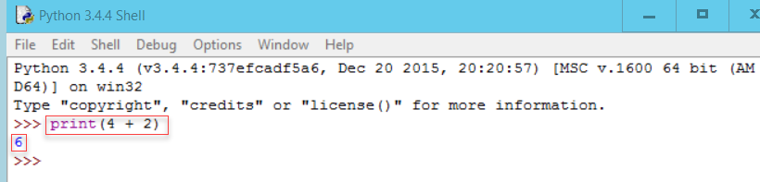
Lesson 1 – How Programs are run
REPL –
Python comes with a REPL environment called IDLE
The first highlighted area is a Python statement
The second is the output produced from executing the statement

Slide 15
Lesson 2
Using words and pictures

Slide 16
Lesson 2
Everyday tasks are often performed automatically. Writing instructions for others to follow can be more difficult.
Exercise – write instructions to do one of the following;
Make a cup of tea
Boil an Egg
You may assume that you are in a well-designed kitchen and everything you are going to need is within arm’s reach.

Slide 17
Comments on the exercise
It is natural to write the instructions as a list of things to do
Although we recognise the tasks as singular, we naturally break them down into sub-tasks
Linear lists do not make it easy to include decisions or choices.
Typically, assumptions will be made. e.g.
gas or electric?
How long do you boil an egg?

Slide 18
Lesson 2 - Before you start coding
Even before deciding on a programming language
There are two techniques which can be used to help in the design of your program
Pseudocode and
Flowcharting
You can use both, you should certainly use one.

Slide 19
Lesson 2 - Pseudo code
In general pseudo code consists of simple English phrases on separate lines.
There are however two key rules;
If a line is dependent on the line before, you indent the line.
Use a set of commonly accepted constructs for selections and actions.

Slide 20
Lesson 2 - Pseudo code
A simple example
If student's grade is greater than or equal to 60 print "passed" else print "failed"
endIf
The second and fourth lines are indented because they depend on the lines above
The If…Else…EndIf construct is used to indicate a selection (do this or do that)

Slide 21
Lesson 2 - Pseudo code
The commonly used constructs
To denote | Use
Loops | Do While...EndDo
 | Do Until...EndDo
Selections | If...Endif
 | If…Else…Endif
 | Case...EndCase
A process or sub-process | Generate
 | Compute
 | Process
An individual action | set, reset, increment, compute, calculate, add, sum, multiply, print, display, input, output, edit, test …

Slide 22
Lesson 2 - Pseudo code Example
set total, counter and average to 0
Input the first score
Do while the user has not entered the final score
add this score to the total
add one to the counter
input the next score
EndDo
if the counter is not equal to 0
set the average to the total divided by the counter
print the average
else
print 'no grades were entered'
endif

Slide 23
Lesson 2 - Flowcharts
A flowchart is a diagrammatic way of representing your algorithm or program
It is a graph with directed lines representing the edges
And a series of symbols representing the nodes
The Symbol used in some way represents the purpose of the node

Slide 24
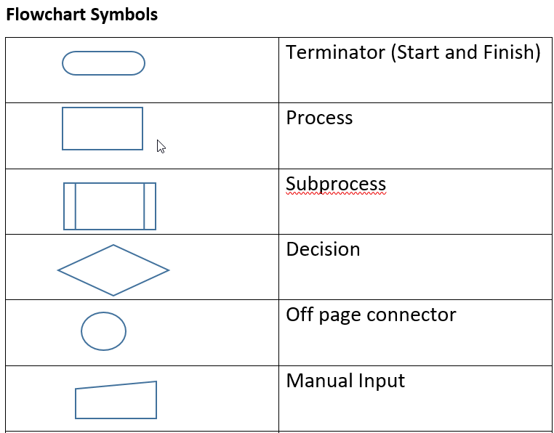
Lesson 2 - Flowcharts
Some of the key symbols are shown here

Slide 25
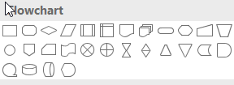
Lesson 2 - Flowcharts
The flowcharting symbols are available from MS Word and other packages
In practice it is normally more convenient to start your flowchart freehand (pen and paper!)

Slide 26
Lesson 2 - Flowcharts
The following slides illustrate how several of the selections and actions referred to in the pseudo code section are realised as flowchart segments.
Remember however that a complete flowchart will consists of many of these segments together so as to represent the complete task.

Slide 27
Lesson 2 – Flowcharts If…Endif
Start
Is colour Blue?
N
Y
Do something for Blue
End

Slide 28
Lesson 2 – Flowcharts If…Else…Endif
Start
Is colour Blue?
N
Y
Do something because it is not Blue
Do something for Blue
End

Slide 29
Lesson 2 – Flowcharts Do While…EndDo
Start
Is condition TRUE
N
Y
Do something
Do something, possibly setting condition to FALSE
End

Slide 30
Lesson 2 – Flowcharts Do Until…EndDo
Start
Do something
Do something, possibly setting condition to FALSE
N
Is condition TRUE
Y
End

Slide 31
Lesson 2 - Flowcharts
The label from the condition don’t have to be Y and N
Start
x <= 0
Value of x?
x > 0
Do something because it is not Blue
Do something for Blue
End

Slide 32
Lesson 2 - Exercise 1
Convert your English task into pseudo-code and a flowchart
Don’t forget:
Gas or Electric?
How do you like your eggs boiled?
Do you take sugar?

Slide 33
Lesson 2 - Exercise 2
The diagram on the next slide is meant to represent a flowchart to decide the largest of 3 (not equal numbers)
Find 2 things wrong with the flowchart and correct them

Slide 34
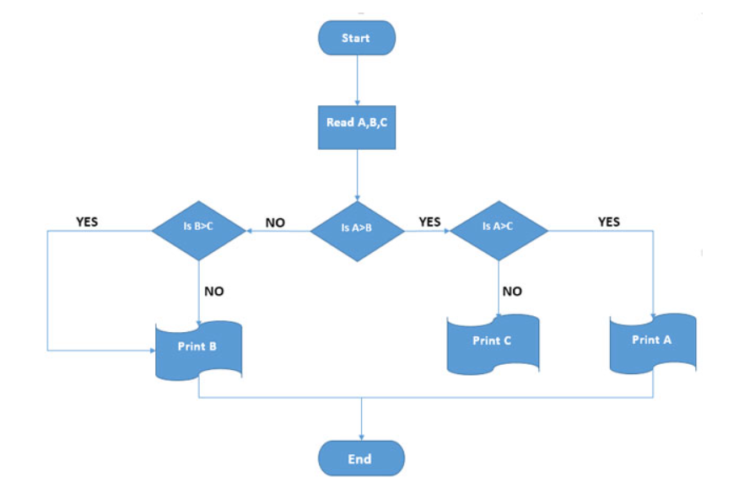
Lesson 2 - Exercise 1
What is wrong with this Diagram?

Slide 35
Lesson 3
Documentation

Slide 36
Lesson 3
All computer programs should be documented
There are two types of documentation
External documentation and
Internal documentation

Slide 37
Lesson 3 - External documentation
Examples
Program Title
Program specification or description
What the program does
How it is to be used
Indication of inputs and outputs
Pseudo-code / Flow charts

Slide 38
Lesson 3 – Internal documentation
All programming languages allow the programmer to include comments in the file of program code.
Different languages have different ways of allowing the programmer to write comments. In Python, there are two different ways
You can use whatever is the more appropriate
All programs should have a block comment at the beginning of the file
In line comments should be used as required but sparingly – you don’t need to comment the obvious

Slide 39
Lesson 3 – Internal documentation
Example
# A comment on a line by itself by starting the line with the '#' sign
print("Hello world") # everything after the '#' is also a comment
"""
You can also have multiline comments
by using the triple quotes at the beginning and end
"""

Slide 40
Lesson 3 – Internal documentation
Block comment at the beginning of the file
"""
Program Name :
Author :
Date written :
Description :
Inputs :
Outputs :
Calls :
Is called by :
"""

Slide 41
Lesson 4
Python programming constructs

Slide 42
Lesson 4 – About Python
Python is a very popular general purpose language which is used extensively for data manipulation and data analysis.
The official Python website is at www.python.org
From here you can download different versions of Python
Complete documentation is also available from the site
If stuck, you can google; ‘how do I … in python’
There will be plenty of responses
Answers from ‘stackoverflow’
Links to official documentation etc.

Slide 43
Lesson 4 – Running Python code
Python code is just text, you can use any text editor
You then need to explicitly run the code
This is rarely done
And almost never during development
When you install Python you will get a small IDE (Interactive Development Environment)
This includes the REPL environment we saw in Lesson 1
This is what we will be using for this workshop
There are most sophisticated environments such as;
PyCharm
Jupyter notebooks

Slide 44
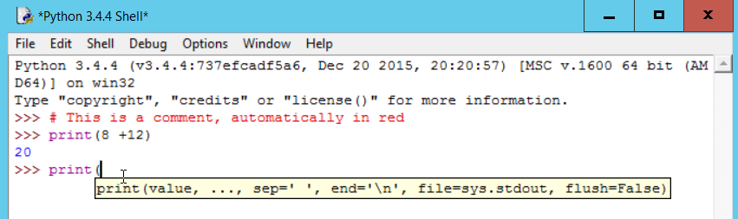
Lesson 4 - IDLE
Notice the colour coding for the different elements
When you type the open bracket for a function, IDLE automatically provides some help
IDLE has many other useful features.

Slide 45
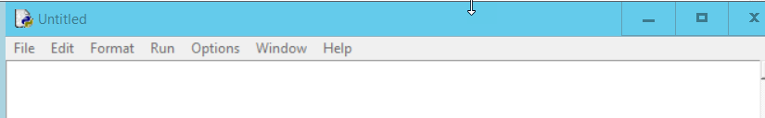
Lesson 4 – more IDLE
You can use IDLE to create a file of code and then run the code as a complete program
This is what you most commonly do when developing
You create a new file (not a new REPL window) by selecting File | New File (or ctrl+N) from the REPL window
This opens a new ‘notepad’ like window with extra options in the menubar

Slide 46
Lesson 4 – more IDLE
You can also open an existing file of Python code using File | Open
Many of the examples for the coding constructs we wish to look at have been pre-written for you in the files you downloaded from GitHub.

Slide 47
Lesson 4
Before we start on the constructs, a little bit about types, variables and operators in Python.

Slide 48
Lesson 4 – simpletypes.py
Types
Int => -2, 0, 1, 200001
Float => -1.0, 0.001, 7689.3452
String => “Hello”, “”, ‘either quotes are OK’
Boolean => True or False
Print(type(variable)) # print the type of the variable
Print(type(variable)) is int # test to see if variable is
# of type int

Slide 49
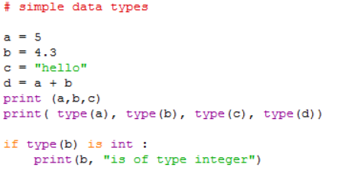
Lesson 4 – simpletypes.py

Slide 50
Lesson 4 – simpletypes.py
We will only be using integers (a), floating point numbers (b) and strings (c).
The type() function will tell you what type a variable is
If you are checking the type in code you use the ‘is’ operator not the ‘==’ operator
variable d is a float because variable b is. If b had been an integer like a then d would also have been an integer

Slide 51
Lesson 4
Variables
x = 1
x = 3.4
x = “Some string value”
Python will change the type of x depending on how you use it
Give variables reasonable name (not like above)

Slide 52
Lesson 4
Arithmetic operators
Usual suspects : + - / *
Also
** (raise to the power) and
% (mod)
Comparison operators
<, >, <=, >=, ==, !=

Slide 53
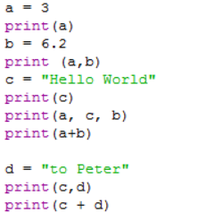
Lesson 4 – print.py

Slide 54
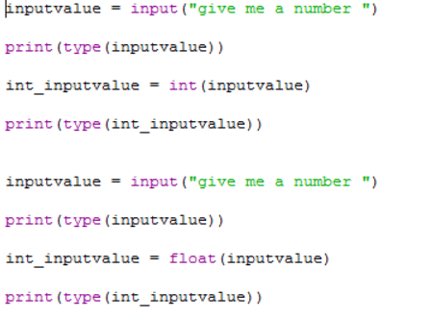
Lesson 4 – input.py

Slide 55
Lesson 4 - Input
Input values are stored as strings. 42 becomes ’42’
If you want a numeric value, the programmer has to convert it using the int() or float() functions
Can be a problem if you are given “Three” and not “3”
Use the ‘try…except’ construct to check

Slide 56
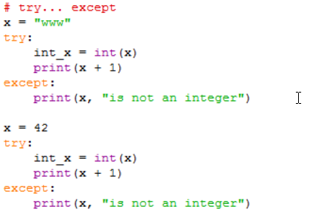
Lesson 4 – tryExcept.py

Slide 57
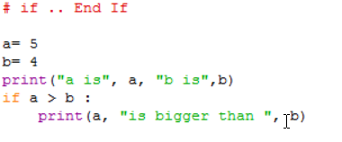
Lesson 4 – if.py

Slide 58
Lesson 4 – if.py
The colon ‘:’ at the end of the ‘if’ line. Missing this out is a common error.
The indentation of the print statement. If you remembered the ‘:’ on the line before, IDLE will automatically do the indentation for you. All of the statements indented at this level are considered to be part of the ‘if’ statement
The equivalent of the ‘EndIf’ is removing the indent.

Slide 59
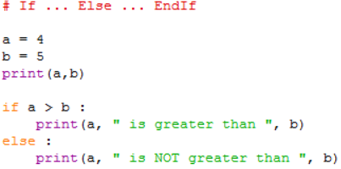
Lesson 4 – ifelse.py

Slide 60
Lesson 4 – ifelse.py
The same structure and formatting rules apply as to the ‘If’ statement.
The block of statements associated with the ‘if’ part is ended by the ‘Else’ clause not being indented.
The ‘Else’ clause also need a ‘:’ at the end of it.

Slide 61
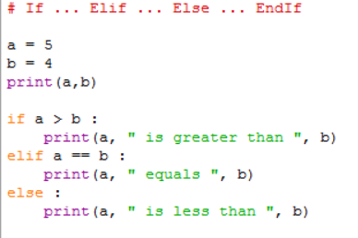
Lesson 4 – ifelif.py

Slide 62
Lesson 4 – ifelif.py
Each ‘Elif’ clause has its own test expression.
You can have as many ‘Elif’ clause as you need
Execution of the whole statement stops after an ‘Elif’ expression is found to be True. Therefore, the ordering of the ‘Elif’ clause can be significant.
Notice that in Python the operator used to check equality is ‘==’

Slide 63
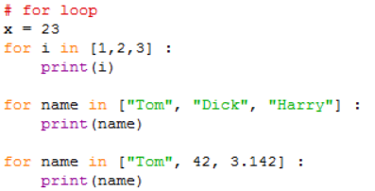
Lesson 4 – for.py

Slide 64
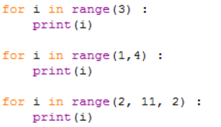
Lesson 4 – for.py

Slide 65
Lesson 4 – for.py
The general format of the ‘for’ loop is:
for <variable> in <sequence>:
<statements>
‘variable’ can be any variable, typically is named and used just for that particular ‘for’ loop or is a general ‘counting’ type variable like ‘i’.

Slide 66
Lesson 4 – for.py
The ‘:’ at the end of the ‘for’ statement. This is required and if you are using IDLE will automatically indent the next line.
‘<sequence>’ is anything that you can count through. In the first example a simple list of integers is used and in the second a list of strings.
The list in the 3rd example has a mixture of data types. This is more a function of lists that the ‘for’ loop

Slide 67
Lesson 4 – for.py
The last 3 examples use the range() built-in function to generate the sequence. You might think that range(3) is equivalent to the list [1, 2, 3] but in fact it is the list [0, 1, 2].
Similarly the range(1, 4) does not equate to the list [1, 2, 3, 4] but to [1, 2, 3]. The first parameter represents the start position in the sequence and the second parameter is one beyond the last value.
In the last example, the 3rd parameter is a step value, so in this case only every second value in the sequence will be used.

Slide 68
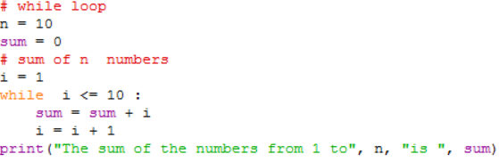
Lesson 4 – while.py

Slide 69
Lesson 4 – while.py
The condition clause (i <= n) in the while statement can be anything which when evaluated would return a Boolean value of either True of False.
The clause can be made more complex by use of parentheses and and and or operators
The statements after the while clause are only executes if the condition evaluates as True.
Within the statements after the while clause there should be something which potentially will make the condition evaluate as False next time around.

Slide 70
Lesson 4 – dountil.py
There is no direct equivalent of the ‘do … until’ construct in Python. Instead a specially designed while loop is used in conjunction with the Python Break statement

Slide 71
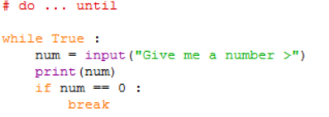
Lesson 4 – dountil.py
There is an error in the code above – What is it?

Slide 72
Lesson 4 – dountil.py
The condition in the while clause is simply the Boolean value True. This means that in theory this program will loop forever (a very common programming error). Instead of using the Boolean value here some people will write an expression like ‘ 1 == 1’.
The if clause is used to check some other condition and if (when) it becomes True, the Break statement is executed.

Slide 73
Lesson 4 – dountil.py
The break statement has the effect of exiting the complete while loop.
You need to make sure within the statements following the while clause there is something which will allow the condition in the if clause to become True.
There is another Python statement ‘continue’ which is similar to Break but only takes you to the end of the current iteration of the loop. This can be useful in the for loop construct.

Slide 74
Lesson 5
Coding Environments

Slide 75
Lesson 5 - Coding environments
This lesson is just a summary a some of the different types of coding environments you might come across

Slide 76
Lesson 5 - Notepad
Advantages
Always available
Disadvantages
Provides no help whatsoever
The code file has to be run separately after it has been created and saved

Slide 77
Lesson 5 – Notepad++
Notepad++ (and others like Atom etc.) is a more sophisticated text editor. It can be told that you are writing Python code
Advantages
You get colour coding of the Python syntax
You get help with function names and autocomplete
Disadvantages
No debugging facilities

Slide 78
Lesson 5 – IDLE
Advantages
Gets installed automatically with Python
Provides Syntax colour coding
Autocomplete of function names
Can run code directly from the REPL or save the code and run immediately
Has debugging facilities
Disadvantages
Not as sophisticated as some other freely available IDES

Slide 79
Lesson 5 – Jupyter Notebooks
Jupyter Notebooks is a web browser based system
Advantages
Syntax colour coding
Debugging
Integrated Documenting system
Can store code and the results of running the code across sessions
Disadvantages
No built-in help with syntax

Slide 80
Lesson 5 – PyCharm
Pycharm is a more substantial IDE than IDLE
Advantages
Same as IDLE
Can run Jupyter notebooks as well
Can manage the installation of packages
More Extensive debugging facilities
Disadvantages
More complex to learn and use

Slide 81
Lesson 6
Debugging

Slide 82

Lesson 6
http://www.anomalies-unlimited.com/Science/Grace%20Hooper.html

Slide 83
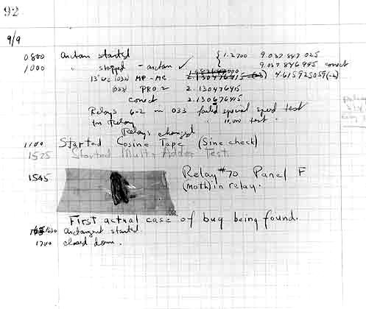
Lesson 6

Slide 84
Lesson 6 - Type of Errors
There are four basic types of errors
Syntax
‘Compile’ time
Run time
Wrong answers

Slide 85
Lesson 6 - Causes of Errors
Error Type | Caused By
Syntax | Written code doesn’t follow the language syntax
‘Compile’ time | Ambiguous or impossible instructions
Run Time | Incorrect Algorithm operation
Wrong answers | Incorrect Algorithm operation

Slide 86
Lesson 6 Causes of Errors
Common causes of errors
Misspelling of variable names
Python is case sensitive
The name Myvar is not the same as myvar
Incorrect logic
Not anticipating what can go wrong
Trying to do arithmetic on string values

Slide 87
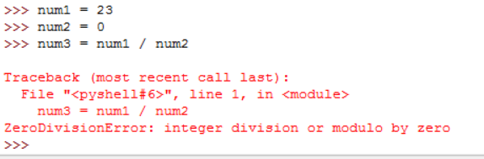
Lesson 6
What does an error look like?
You may get many line of cryptic messages. Generally it is only the last one which is of interest to you – hopefully holding a clue to the problem

Slide 88
Lesson 7
More Python

Slide 89
Lesson 7 - Lists
A list is a group or sequence of items of any type.
We used lists when we were looking at the ‘for’ loop construct

Slide 90
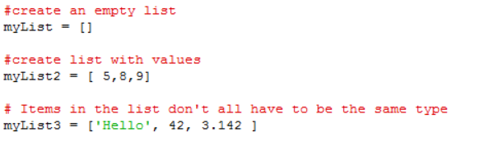
Lesson 7 – lists.py

Slide 91
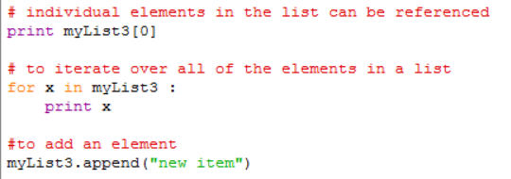
Lesson 7 – lists.py

Slide 92
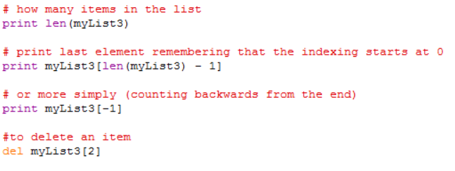
Lesson 7 – lists.py

Slide 93
Lesson 7 – lists.py
Lists are enclosed with [] brackets.
The entries in the list don’t have to be the same type.
Individual items can be accessed by using the index number in {} brackets. Remember that indexing starts at 0 not 1
To access all of the items, you can iterate over them using a ‘for’ loop.
Items can be added using the append() function and removed using the del() function.

Slide 94
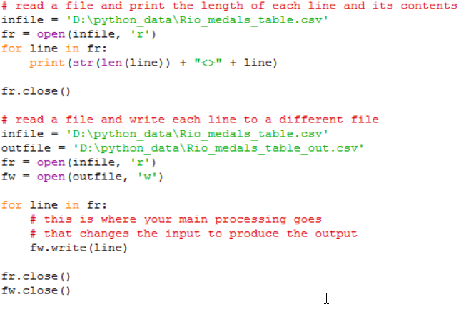
Lesson 7 – files.py

Slide 95
Lesson 7 – Reading and Writing files
The basic function to work with a file is open(). It takes two parameters the first is the name of the file you wish to open and the second indication of how you intend to use the file. (‘r’ = read, ‘w’ = write, ‘a’ = append)
If you say you are going to write to a file and it doesn’t exist, then it will be created for you.
If you say you are going to write to a file and it does exist, then you will overwrite any existing content

Slide 96
Lesson 7 – Reading and Writing files
Append will also create the file if needed, but if the file does exist then anything written is written at the end of the existing contents in the file
The open() function returns a value of type file. This is often referred to as a file handle.
A type of file is iterable. You can think of the file as being a list of items where each item is a single record in the file

Slide 97
Lesson 7 – Reading and Writing files
Because it is iterable you can use the file as the sequence in a for loop in order to process each line of the file in turn. the loop variable (line in the examples) will automatically contain the next record read from the file.
You write records to a file using the write() function of the file handle associated with the file you are writing to. In the example fw.write(line). line in this case is the whole record read but it could be any string value.

Slide 98
Lesson 7 – Reading and Writing files
If you just wanted to read a single record from a file you could use a statement like; ‘line = fr.readline()’
When you have finished processing a file you should close the file using the close() procedure of the file handle (e.g fr.close() )

Slide 99
Lesson 7 - String functions
The is a whole variety of string functions available in Python. A full list is provided in the official documentation for v3.x here https://docs.python.org/3/library/string.html#string-functions .
We have already seen the len() function when we looked at lists
We will now look at the very important ‘split’ function
Unlike the len() function where the string is passed as a parameter, the split function is built-in to every string
You use it by writing something like;
mysplitupstring = mystring.split(“,”)

Slide 100
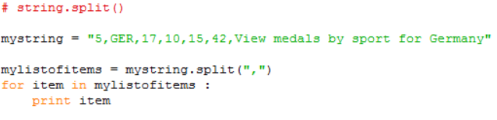
Lesson 7 - split.py
split is a function which returns a list of strings.
The single parameter to split is the character that you want to split the string on. A ‘,’ being quite typical, for a csv file format, but it could be any single character.

Slide 101
Lesson 7 - Functions & Procedures
The difference between a function and a procedure is that a function returns a value and a procedure does not.
Print() is a procedure because it return a value, it just does something
Len() is a function because it returns the length of a string, which you will typically assign to a variable

Slide 102
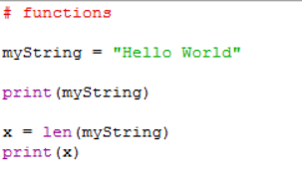
Lesson 7 - functions.py

Slide 103
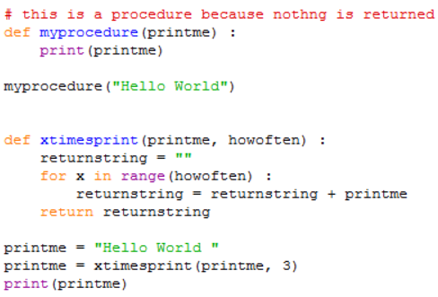
Lesson 7 - Writing your own Functions

Slide 104
Lesson 7 - Writing your own Functions
The definition of a function (or procedure) starts with the def keyword and is followed by the name of the function with any parameters used by the function in brackets.
The definition clause is terminated with a ‘:’ which causes indentation on the next and subsequent lines. All of these lines form the statements which make up the function. The function ends after the indentation is removed.
Within the function, the parameters behave just like variables whose initial values will those that they were given when the function was called.

Slide 105
Lesson 7 - Writing your own Functions
functions have a return statement which specifies the value to be returned. This is the value assigned to the variable on the left-hand side of the call to the function. (printme in the example above)
You call (run the code) a function simply by providing its name and values for its parameters just as you would for any builtin function.

Slide 106
Lesson 8
Introduction to Testing

Slide 107
Lesson 8 - Testing
“If your program works first time, it probably wasn’t worth writing”
(anon)

Slide 108
Lesson 8 - Testing
In Lesson 6 we said that:
Testing is a planned process which aims to discover if anything is wrong with the program code. We also said that the most likely problem was that the programming logic for the algorithm was incorrect

Slide 109
Lesson 8 - Testing
Perhaps an indication of how important software testing is considered to be, is the fact that it is covered by a set of ISO (International Standards Organisation) Standards
(ISO 20119-1 to 5).

Slide 110
Lesson 8 – Testing
All programs should be tested. Whether they appear to be working or not
How much depends on size and complexity
How do we know when we have done enough testing?

Slide 111
Lesson 8 - Testing
The answer to the question; When have we done enough testing? is often quoted as;
‘When you have either run out of money or run out of time’

Slide 112
Lesson 8 - Testing
Testing approach
Have a plan! – start it early!
Know what you are testing for
Know what results you expect from any given set of test conditions

Slide 113
Lesson 8 - Testing
Start test plan construction as soon as possible
Some tests can be designed before the code is written
You should aim to test for all reasonable values or ranges of input variables
So you need to know what they are,
Their types
Their valid ranges
And combinations of these

Slide 114
Lesson 8 – Testing - Example tests
For numerical variables test for
Either side of the min and max points
A central point
Real where integer expected
-ve if only +ve expected ( and vice versa)
For string variables test for
Empty string
Overlength strings
Strings on in pre-defined list
Upper and lower case combinations

Slide 115
Lesson 8 – Testing - Example tests
For boolean variables test for
All combinations of True and False
0 and 1 (make sure you know which is which)
0 and -1 (make sure you know which is which)
All combinations of Y, y, N, n, Yes, yes, No, no etc.
Empty string

Slide 116
Lesson 8
In addition to testing variables individually, you need to test them in combination with others
e.g. if 0 <= x < 20, then 0 <= y < 8000
It is the testing of the variables in combination that allows you to test the various branches in the code

Slide 117
Lesson 8 – The Test plan
Test plans and Test results should always be recorded
Use a test sheet to record:
What the test is testing
The values that the variables are to be given
Most importantly – The expected results
The actual results

Slide 118
Lesson 8 – Testing example
As an Example we will re-consider our flawed flowchart from lesson 2
The program it represents is intended to find the largest of three (all non-equal integers) variables A, B and C
As the variables are arbitrarily named and each represents an integer we can use values of 1, 2 and 3 and assign them in all combinations to A, B, and C
This will result in a set of 6 tests shown on the next but one slide

Slide 119
Lesson 8 – Testing example

Slide 120
Lesson 8 – Testing example
Test No. | 1 | 2 | 3 | Expect result | Actual Result | Pass / Fail
1 | A | B | C | C | B | Fail
2 | A | C | B | B | B | Pass
3 | B | A | C | C | C | Pass
4 | B | C | A | A | A | Pass
5 | C | A | B | B | B | Pass
6 | C | B | A | A | A | Pass

Slide 121
Lesson 8 – Testing - VVT
VVT stands for Verification, Validation and Testing.
Testing we have already described as checking if anything wrong with the program code.
Validation considers; Have we written the right program? Does it match the specification we were given?
Verification considers; Have we written the program right? Does the programming logic we have used result in getting the right answers?
Verification and Validation can require tests of their own

Slide 122
Lesson 9
Python packages

Slide 123
Lesson 9 - Python Packages
Python is an extensible language
There are 100’s of additional ‘packages’ which can be added
Included in the Python installation is a program called ‘pip’
Pip is a command line program used to install packages

Slide 124
Lesson 9
From a command line prompt you should be able to call pip directly.
The table below shows the common usages of pip.
Command | What it does
>pip list | Lists all of the packages currently in your Python installation
>pip search * | Provides a list of all available packages (requires Internet connection)
>pip install <package name> | Installs the given package

Slide 125

Lesson 9
You use the import command to import a package
You prefix the package function with the package name

Slide 126

Lesson 9
The dir() command lists the functions in the package
The help() command will give a description of the function

Slide 127
Lesson 10
Your Turn!

Slide 128
Lesson 10 - Exercise Hints
Break the problem into 2 parts.
Part 1
User input to get the two country codes
Read the file to find the two records relating to the country codes
Extract the Gold, Silver and Bronze medal counts
Keeping track of which is which
You need to test whether
Both of the country codes exist
They were supplied in the correct order
These can effectively be done as you read the file

Slide 129
Lesson 10 - Exercise Hints
Part 2
Calculate the differences of Gold, Silver and Bronzes between the two countries
The difference in the Golds has to be >= 0
For Silvers and Bronzes the difference could be any value.
Draw a flowchart which illustrates what can happen if the difference in bronzes is either <0 or >= 0. For these two branches consider the situation for Silver and for these four branches consider the situation for Gold
You could do the flowchart starting with Gold and work down. The resulting eight options will be the same
You may find it useful to create a test table of the possibilities similar to what we did in Lesson 8.

Slide 130
Peter Smyth
Peter.smyth@manchester.ac.uk
ukdataservice.ac.uk/help/
Subscribe to the UK Data Service news list at https://www.jiscmail.ac.uk/cgi-bin/webadmin?A0=UKDATASERVICE
Follow us on Twitter https://twitter.com/UKDataService
or Facebook https://www.facebook.com/UKDataService

